Slide 1

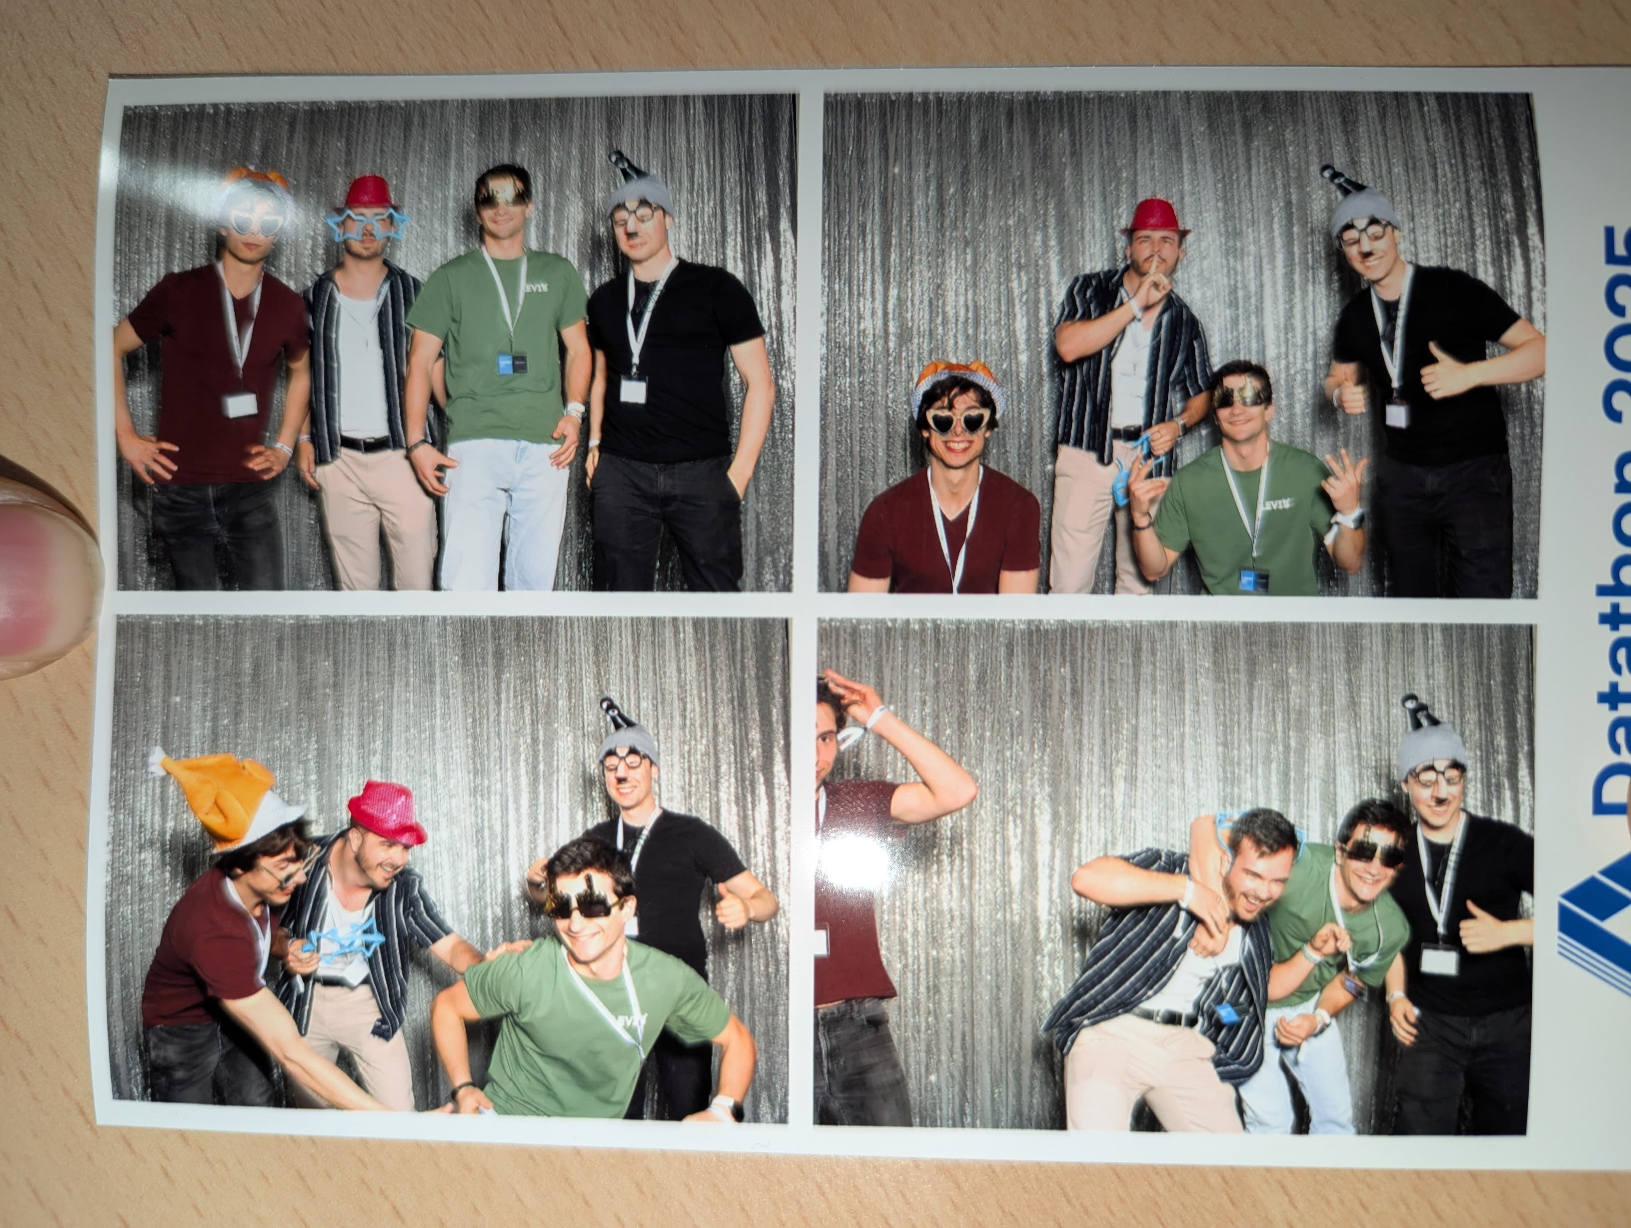
Sentient Challenge by Blubomberbing
Team:
Andrea Ghirlanda
Patrick Zimmermann
Virgilio Strozzi
Max Krähenmann

Slide 2
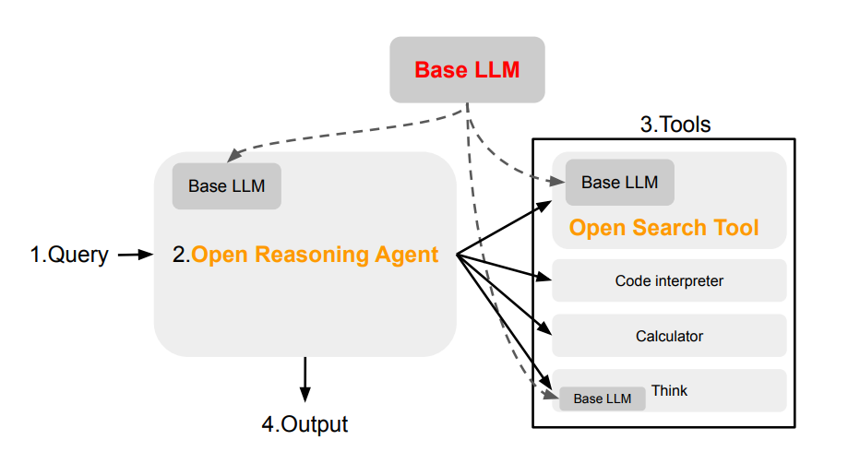

Framework
Llama 70B for all LLM tasks
Added:
SPARQL Wikipedia Tool
Code Interpreter Tool
CoT + Code Interpreter Tool
-> More Flexibility
New prompts

Slide 3

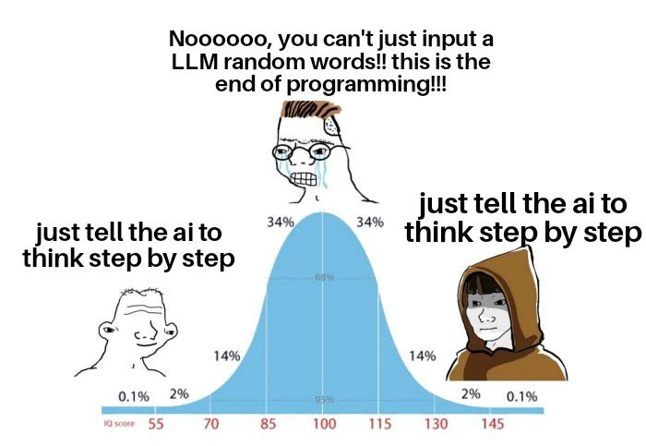
Further ideas
Integrate more Smolagents
Improve WikiAgent
Create More Prompts
Prompt Engineering

Slide 4

Results
Generating

Slide 5
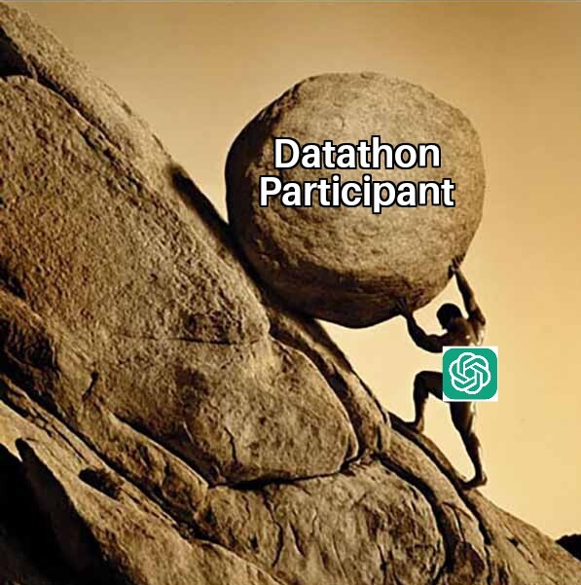

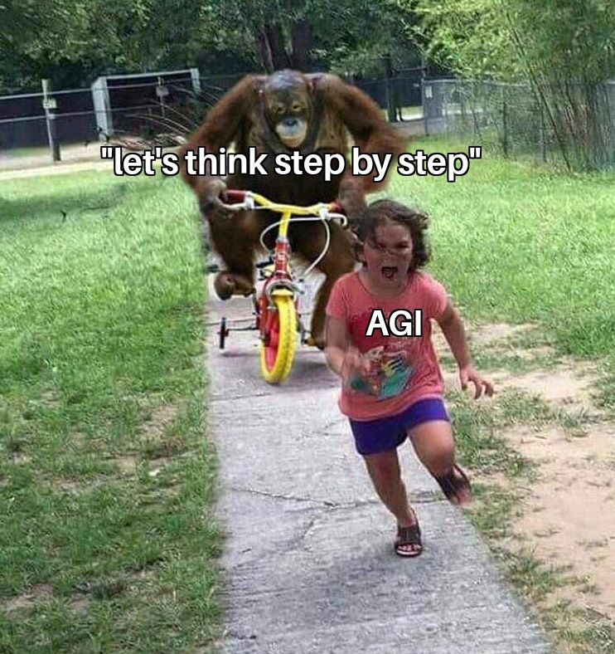
Our Expericen

